Slide 1
BOOC
CREDIT CARD AND BT
SCORING PROGRAM
DOCUMENTATION
Covers Version 1.28
January 12, 2007
Decision Analytics Consulting

Slide 2
CONTENTS
Technical highlights
Input and output environment
Application Programming Interface
Program flow
Program files

Slide 3
TECHNICAL HIGHLIGHTS
Windows-based DLL
Developed with Borland C++ Builder 6
Require Microsoft SQL server 2000 database to operate
Require the following eight Borland run-time library to operate:
  adortl60.bpl − borlndmm.dll − cc3260mt.dll
  dbrtl60.bpl − rtl60.bpl − stlpmt45.dll
  vcl60.bpl − vclx60.bpl
Connect to database via Microsoft ADO (Active Data Objects)

Slide 4
CONTENTS
Technical highlights
Input and output environment
Application Programming Interface
Program flow
Program files

Slide 5
INPUT ENVIRONMENT
 | Application / IT data | JCIC data
Application programming interface | Data retrieval keys DB connection string | None
SQL server 2000 database tables | APP_INFO APP_I (BT only) | JCIC atoms (each atom comprise one table)

Slide 6
INPUT ENVIRONMENT (CONT.)
Application data
  Common
    Product code • Gender • Sales channel
    Date of birth • Income • Education
    Current company • Current job title • Tenure with current company
    Martial status • 3-digit residence zip code
  Credit card
    Interest rate • Card type
  Balance transfer
    BT amount • No of BT • Teaser period
    BT fee month • BT fee code • BT fee / percentage
    APRs

Slide 7
INPUT ENVIRONMENT (CONT.)
IT
  OLE_DB (the database connection string)
JCIC data
  JCIC atoms include:
    BAM087 • JAS002 • KRM021
    KRM023 • KRM040 • STM007

Slide 8
DETAILED APP_INFO TABLE DEFINITION
Column name | Data type | Description | NULL permitted
CASE_SN | Char(12) | 案件編號 | No
IDN | Char(11) | 身分證號 | No
APPLICATION_DATE | Char(8) | 申請日期(YYYYMMDD) | No
PRODUCT_CODE | Int | 性質別(1：信用卡；2：餘額代償) | No
BT_AMOUNT | Int | 代償金額(新台幣元；若非代償則為0) | No
NO_OF_BT | Int | 代償比數 | No
TEASER_PERIOD | Int | 代償優惠總期數(月) | No
BT_FEE_CODE | Int | 代償手續費收取方式(1：金額；2：餘額百分比) | No
BT_FEE | Int | 每比每月代償手續費 | Yes
BT_FEE_PERCENTAGE | Float | 每月代償手續費百分比(0.99%為0.0099) | Yes
CC_INTEREST_RATE | Float | 信用卡年利率(19.71%為0.1971) | No
Gender | Int | 性別 | No
CHANNEL | Char(20) | 銷售管道 | Yes
ZIP | Char(3) | 居住地三碼郵遞區號 | Yes

Slide 9
DETAILED APP_INFO TABLE DEFINITION(CONT.)
Column name | Data type | Description | NULL permitted
CARD_TYPE | Char(1) | 卡別(產品別) / 卡樣 (P：白金卡；G：金卡；C：普卡) | No
DOB | Char(8) | 出生年月日(YYYYMMDD) | No
INCOME | Int | 年收入(新台幣元) | Yes
EDUCATION | Char(1) | 學歷 | Yes
COMPANY_NAME | Varchar(48) | 現任職公司名稱 | Yes
JOB_TITLE | Varchar(32) | 現任職稱 | Yes
TENURE | Int | 於現任公司服務年資 | Yes
BT_FEE_MONTH | Int | 代償手續費收取月數 | No
MARTIAL_STATUS | Char(1) | 婚姻狀態 | No
CASH_CARD_UTIL_CAP | Float | 現金卡使用百分比上限(95%為0.95) | Yes
CREDIT_CARD_UTIL_CAP | Float | 信用卡循環使用比例限制(75%為0.75) | Yes
CC_BALANCE_CAP | Float | 信用卡循環與現金卡餘額上限(新台幣元) | Yes

Slide 10
DETAILED APP_I TABLE DEFINITION
Column name | Data type | Description | NULL permitted
CASE_SN | Char(12) | 案件編號 | No
IDN | Char(11) | 身分證號 | No
SEQ | Int | 利率時段流水號 | No
APR | Float | 年利率(%)，徵審系統提供最終利率(3.5%為0.035) | No
PERIODS | Int | 適用時段 | No

Slide 11
DETAILED JCIC TABLES DEFINITIONS
KRM023
Column name | Data type | Description | NULL permitted
CASE_SN | Char(12) | 案件編號 | No
IDN | Char(11) | 身分證號 | No
YRMON | Char(5) | 資料年月(YYYMM, YYY為民國年) | Yes
ISSUE | Char(3) | 發卡機構代號 | No
ISSUE_NAME | Char(40) | 發卡機構名稱 | Yes
KR_CODE | Char(7) | 信用卡別 | Yes
LIMIT | Char(5) | 核定額度(新台幣千元) | Yes
PAYMENT | Char(3) | 應繳金額級距(元)(位數+HML) | Yes
CASH | Char(1) | 預借現金有無(Y/N) | Yes
PAY_CODE | Char(1) | 繳款狀況代號 | Yes

Slide 12
DETAILED JCIC TABLES DEFINITIONS
KRM021
Column name | Data type | Description | NULL permitted
CASE_SN | Char(12) | 案件編號 | No
IDN | Char(11) | 身分證號 | No
CARD_BRAND | Char(1) | 卡名代號 | Yes
CARD_TYPE | Char(1) | 標章代號 | Yes
ISSUE | Char(3) | 發卡機構代號 | Yes
ISSUE_NAME | Char(40) | 發卡機構名稱 | Yes
START_DATE | Char(7) | 啟用日期(YYYMMDD, YYY為民國年) | Yes
STOP_DATE | Char(7) | 停用日期(YYYMMDD, YYY為民國年) | Yes
STOP_CODE | Char(1) | 停用種類代號 | Yes

Slide 13
DETAILED JCIC TABLES DEFINITIONS
KRM021(CONT.)
Column name | Data type | Description | NULL permitted
AB_CODE | Char(1) | 停用原因代號 | Yes
M_S | Char(1) | 主附卡 (YN) | Yes
LIMIT | Char(6) | 額度（新台幣千元） | Yes
RISK | Char(6) | 〔僅停用原因＝Ｐ〕風險損失金額（千元） | Yes
CLEAR_DATE | Char(7) | 〔僅停用原因＝Ｕ〕欠款結清日期 | Yes
PIDN | Char(10) | 〔僅附卡〕主卡人身分證號 | Yes
CNAME | Char(12) | 〔僅附卡〕主卡人姓名 | Yes
REMARK | Char(40) | 註記 | Yes

Slide 14
DETAILED JCIC TABLES DEFINITIONS
BAM087
Column name | Data type | Description | NULL permitted
CASE_SN | Char(12) | 案件編號 | No
IDN | Char(11) | 身分證號 | No
DATA_YYY | Char(3) | 資料年度(民國年) | Yes
DATA_MM | Char(2) | 資料月份 | Yes
BANK_CODE | Char(7) | 行庫代號 | Yes
BANK_NAME | Char(40) | 行庫名稱 | Yes

Slide 15
DETAILED JCIC TABLES DEFINITIONS
BAM087(CONT.)
Column name | Data type | Description | NULL permitted
ACCOUNT_CODE | Char(1) | 會計科目 | Yes
ACCOUNT_CODE2 | Char(1) | 會計科目註記 | Yes
PURPOSE_CODE | Char(1) | 用途別 | Yes
CONTRACT_AMT | Int | 本階訂約金額 (新台幣千元) | Yes
CONTRACT_AMT1 | Int | 最高階訂閱金額(新台幣千元) | Yes
LOAN_AMT | Int | 放款未逾期 (新台幣千元) | Yes
PASS_DUE_AMT | Int | 逾期未還金額 (新台幣千元) | Yes
PAY_CODE_12 | Char(12) | 最近12個月還款紀錄 | Yes
CO_LOAN | Char(1) | 共同借款註記 | Yes
ACT_Y_MARK | Char(1) | Ｙ科目之額度註記 | Yes
CONTRACT_AMT_Y | Int | 現金卡日報Ｙ科目之可動用額度 (新台幣千元) | Yes

Slide 16
DETAILED JCIC TABLES DEFINITIONS
JAS002
Column name | Data type | Description | NULL permitted
CASE_SN | Char(12) | 案件編號 | No
IDN | Char(11) | 身分證號 | No
EVER_DELINQUENT | Char(1) | 授信異常 (Y/N) | Yes
DELINQUENT_DATE | Char(7) | 最近授信異常日期 | Yes
EVER_BAD_CHECK | Char(1) | 退票異常 (Y/N) | Yes
BAD_CHECK_DATE | Char(7) | 最近退票異常日期 | Yes
EVER_REJECT | Char(1) | 拒絕往來紀錄 (Y/N) | Yes
REJECT_DATE | Char(7) | 拒絕往來日期 | Yes
EVER_STOP_CARD | Char(1) | 強制停卡異常 (Y/N) | Yes
STOP_CARD_DATE | Char(7) | 最近強制停卡日期 | Yes

Slide 17
DETAILED JCIC TABLES DEFINITIONS
STM007
Column name | Data type | Description | NULL permitted
CASE_SN | Char(12) | 案件編號 | No
IDN | Char(11) | 身分證號 | No
QUERY_DATE | Char(7) | 查詢日期(YYYMMDD, YYY為民國年) | Yes
BANK_CODE | Char(7) | 查詢單位代號 | Yes
BANK_NAME | Char(40) | 查詢單位名稱 | Yes
ITEM_LIST | Char(10) | 查詢項目串列 B:授信 D:票信 K:信用卡等 | Yes
INQ_PURPOSE_1 | Char(1) | 查詢理由碼 | Yes
INQ_PURPOSE | Char(22) | 查詢理由碼(中文註解) 1:新業務申請2:原業務往來 3 :新業務申請及原業務往來 | Yes

Slide 18
DETAILED JCIC TABLES DEFINITIONS
KRM040
Column name | Data type | Description | NULL permitted
CASE_SN | Char(12) | 案件編號 | No
IDN | Char(11) | 身分證號 | No
BILL_DATE | Char(7) | 結帳日(YYYMMDD, YYY為民國年) | Yes
ISSUE | Char(3) | 發卡機構代號 | Yes
ISSUE_NAME | Char(24) | 行庫代號 | Yes
BILL_MARK | Char(2) | 帳單別註記
CARD_TYPE | Char(7) | 信用卡別 | Yes
PERM_LIMIT | Int | 永久額度(新台幣千元) | Yes
TEMP_LIMIT | Int | 臨時額度(新台幣千元) | Yes
CASH_LIMIT | Int | 預借現金額度(新台幣千元) | Yes
PAYABLE | Int | 本期應付帳款(新台幣元) | Yes
CASH_LENT | Int | 本期預借現金(新台幣元) | Yes

Slide 19
DETAILED JCIC TABLES DEFINITIONS
KRM040(CONT.)
Column name | Data type | Description | NULL permitted
LAST_PAYA | Int | 上期應付帳款(新台幣元，可能為負值) | Yes
REVOL_BAL | Int | 上期循環信用(新台幣元) | Yes
PAY_STAT | Char(1) | 上期繳款狀況代號(金額) | Yes
PAY_CODE | Char(1) | 上期繳款狀況代號(時間)
REVOL_RATE | Int | 上期循環比率 REVOL_BAL/PERM_LIMIT 精確度至小數點後2位(四捨五入);非百分比 | Yes
PRE_OWED | Int | 未到期分期償還待付金額 未到期代墊消費款金額+未到期分期償還預借現金金額 ,不包括本期新增餘額代償 | Yes
DEBT_CODE | Char(1) | 債權狀況註記 | Yes
CLOSE_CODE | Char(1) | 債權結案註記 | Yes
CLEAR_DATE | Char(7) | 不良債權結案日期(YYYMMDD, YYY為民國年) | Yes

Slide 20
OUTPUT ENVIRONMENT
 | Error messages | Results
Application programming interface | Abnormal termination Input data error Module expiration | None
SQL server 2000 database tables | None | RESULT

Slide 21
OUTPUT ENVIRONMENT (CONT.)
Error messages
  Abnormal termination
    Network failures • DB failures • Hardware failures
  Module expiration
    System date passes the hard-wired expiration date
Module result
  RESULT
    Stores module calculation result

Slide 22
DETAILED RESULT TABLE DEFINITION
Column name | Data type | Description | NULL permitted
CASE_SN | Char(12) | 案件編號 | No
IDN | Char(11) | 身分證號 | No
APPLICATION_DATE | Char(8) | 申請日期(YYYYMMDD) | No
SUGGESTED_LINE | Int | 核准模組建議額度或代償金額(新台幣元) | No
PRODUCT_CODE | Int | 性質別(1：信用卡；2：餘額代償) | No
RESULT_CODE | int | 核准模組輸出訊息代碼 | No
RESULT_MESSAGE | Char(256) | 核准模組輸出訊息 | No
EV | Decimal(16,2) | 經濟效益(新台幣元) | Yes
PB | Decimal(10,6) | 壞帳機率 (5%為0.05) | Yes
PROPENSITY_GROUP | Int | 使用傾向等級(廿級) | Yes
RISK_GROUP | Int | 風險等級(廿級) | Yes
DOLLAR_BAD | Decimal(5,4) | 預計壞帳金額比(5%為0.05) | Yes

Slide 23
REFERENCE ENVIRONMENT
One SQL Server database tables
PARAMETERS
  Contains dollar bad mapped from
    Propensity twentile
    Risk twentile
    Line granted by the approval module
  Update whenever there is a new mapping

Slide 24
DETAILED REFERENCE TABLE DEFINITION
PARAMETERS
Column name | Data type | Description | NULL permitted
P1 | Int | Risk twentile | No
P2 | Int | Propensity twentile | No
P3 | Int | Line (in NT$0000) | No
P4 | Float | Dollar bad | No

Slide 25
CONTENTS
Technical highlights
Input and output environment
Application Programming Interface
Program flow
Program files

Slide 26
APPLICATION PROGRAMMING INTERFACE
int BOOC_CC_BT_AM
(char *case_sn, char *idn, char *product_type,
char *bank_code, char *ole_db, int gender, char *error)
Return value: 0 if the module runs normally,
-1 if the module does not run normally,
the string “*error” contains the error message.
case_sn: Application sequence number from approval system
idn: National id of the one being scored
product_type: credit card (1) / BT (2)
ole_db: Microsoft SQL Server ADO connection string
bank_code: bank id (for BOOC, it is ‘010’)
gender: Gender of the loan applicant, 0 for female, 1 for male

Slide 27
CONTENTS
Technical highlights
Input and output environment
Application Programming Interface
Program flow
Program files

Slide 28
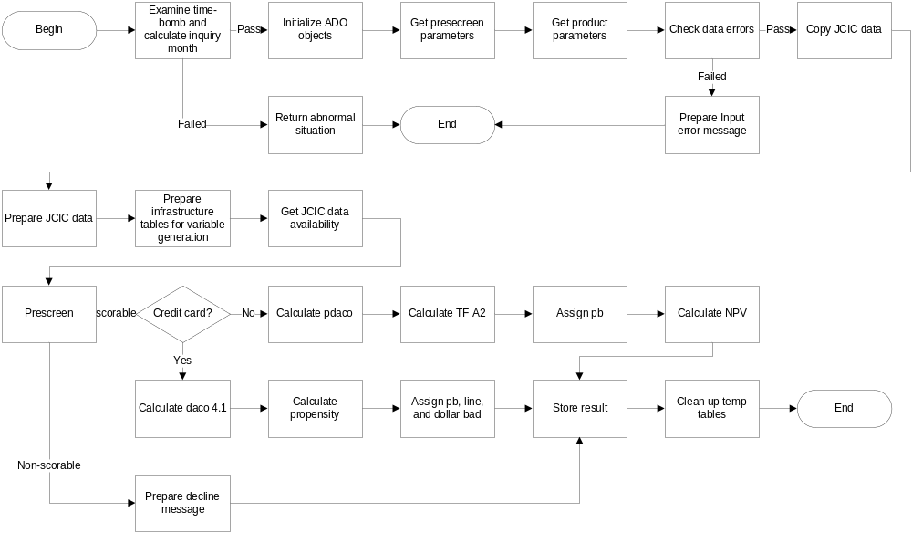
PROGRAM FLOW OVERVIEW
Notes:
Size: H 4.01” W 9.00”
Position: V 0.33” H 1.92”

Slide 29
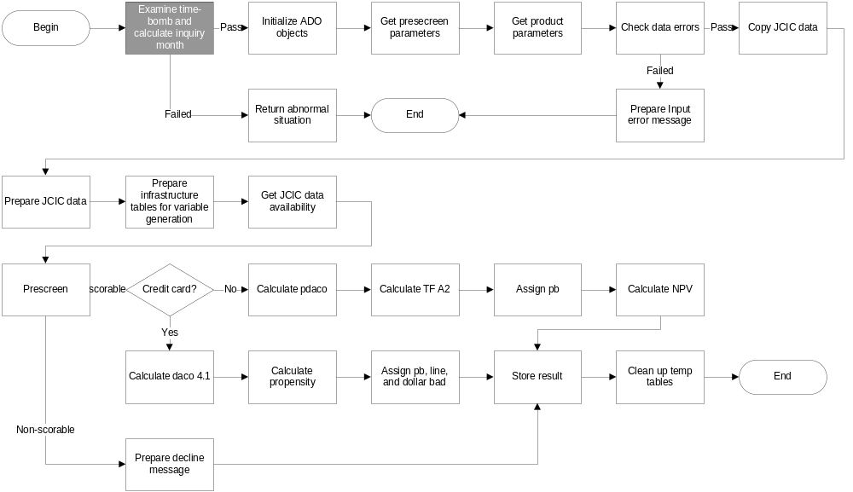
EXAMINE TIME-BOMB AND CALCULATE INQUIRY MONTH
Notes:
Size: H 4.01” W 9.00”
Position: V 0.33” H 1.92”

Slide 30
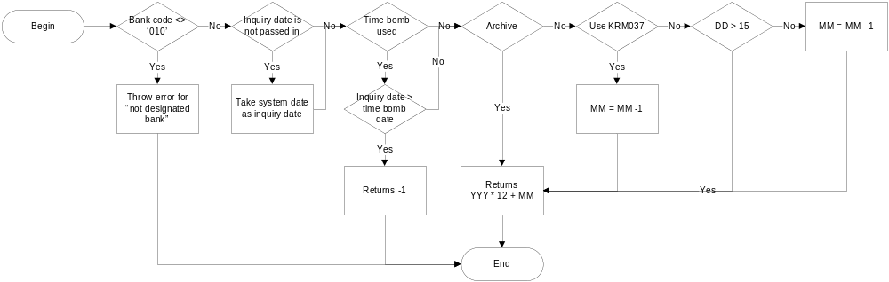
EXAMINE TIME-BOMB AND CALCULATE INQUIRY MONTH

Slide 31
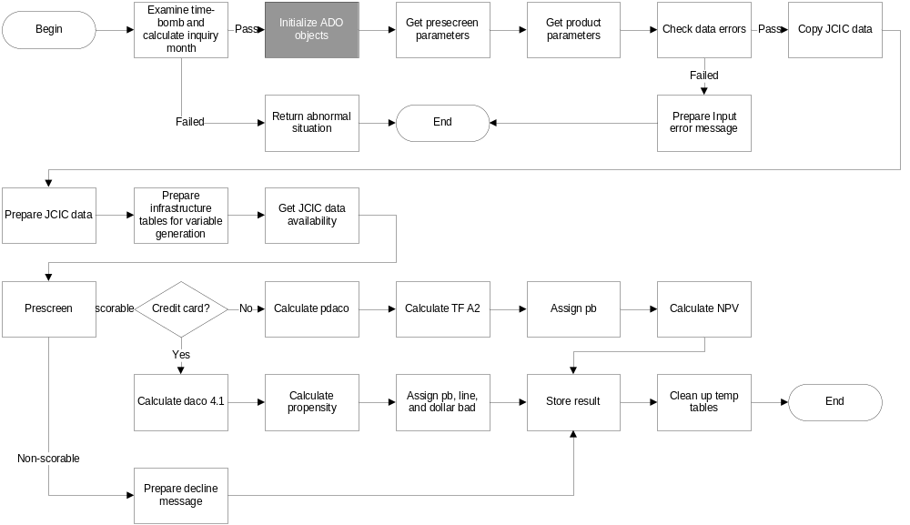
INITIALIZE ADO OBJECTS

Slide 32
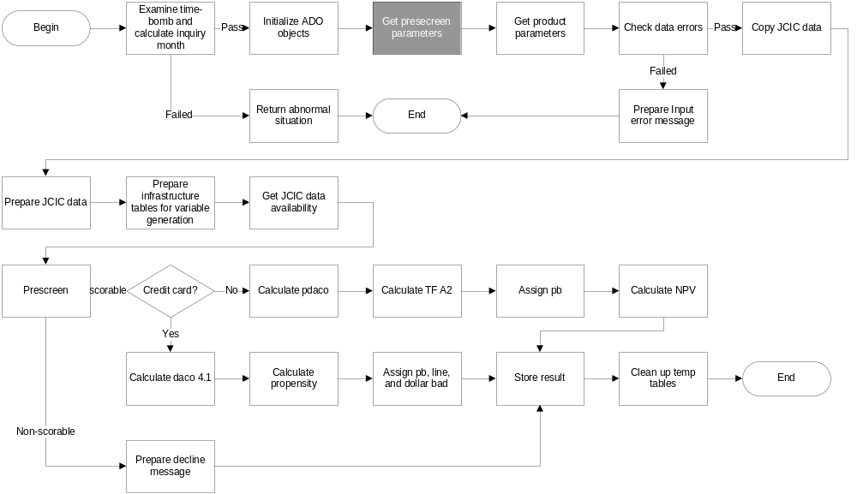
GET PRSCREEN PARAMETERS

Slide 33
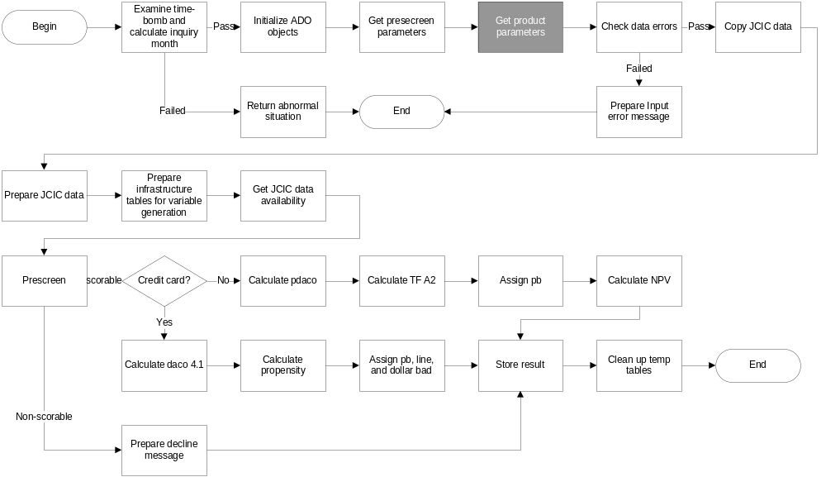
GET PRODUCT PARAMETERS

Slide 34
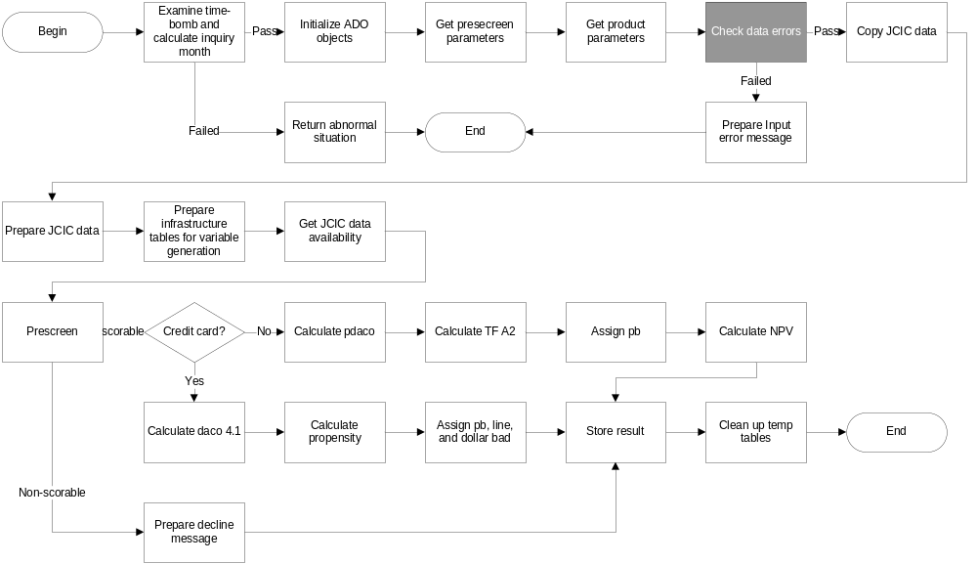
CHECK DATA ERRORS

Slide 35
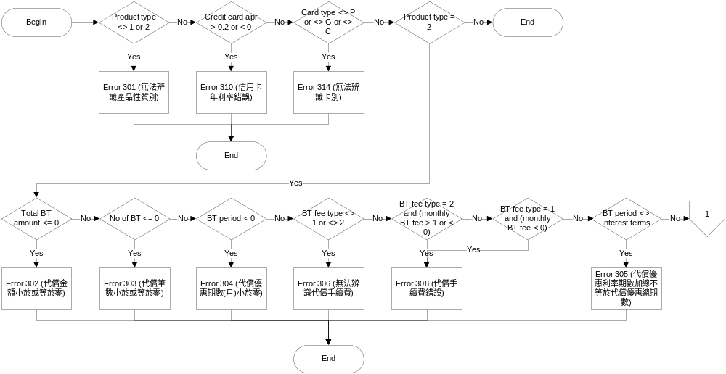
CHECK DATA ERRORS

Slide 36
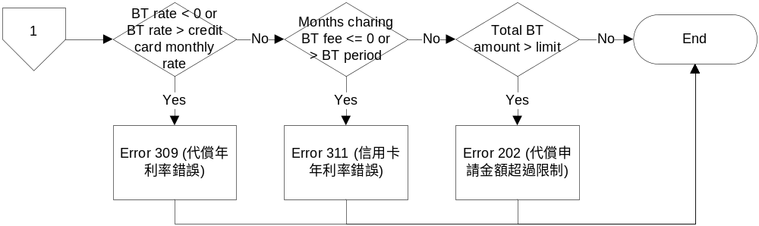
CHECK DATA ERRORS(CONT.)

Slide 37
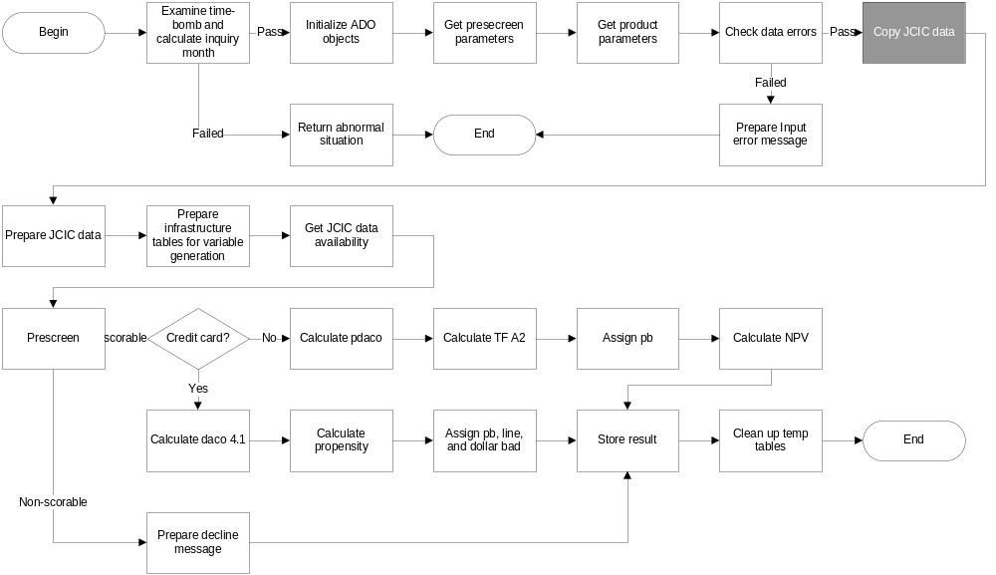
COPY JCIC DATA

Slide 38
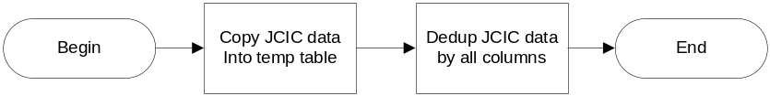
COPY JCIC DATA
JCIC data includes:
BAM087
JAS002
KRM021
KRM023
KRM040
STM007

Slide 39
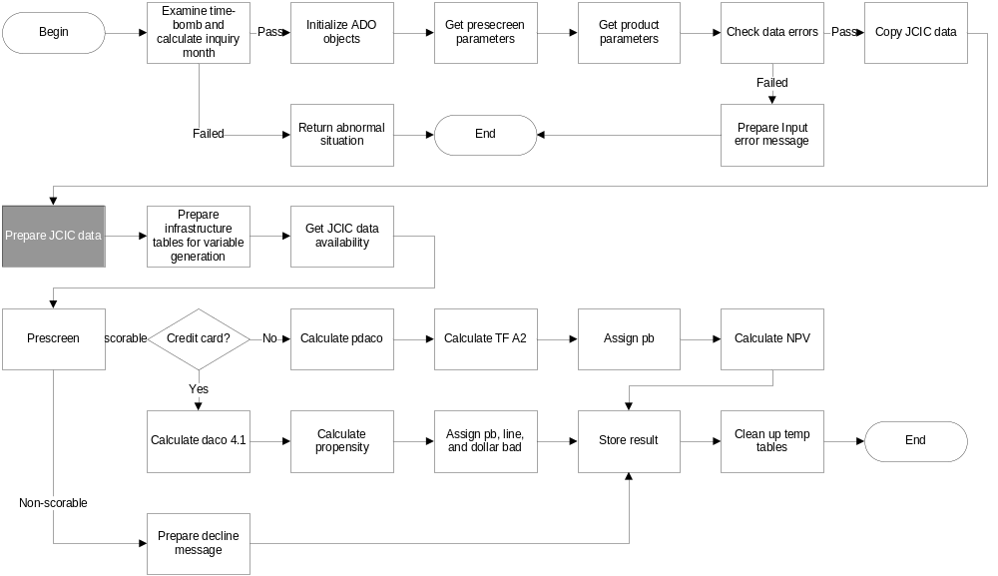
PREPARE JCIC DATA

Slide 40
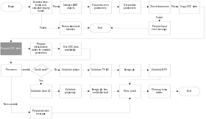
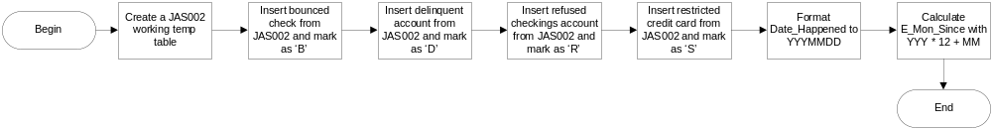
PREPARE JCIC DATA
JAS002
KRM021
STM007

Slide 41
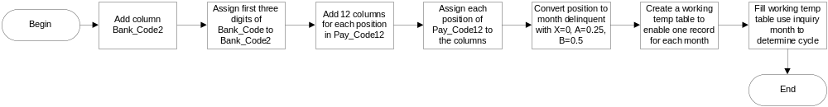
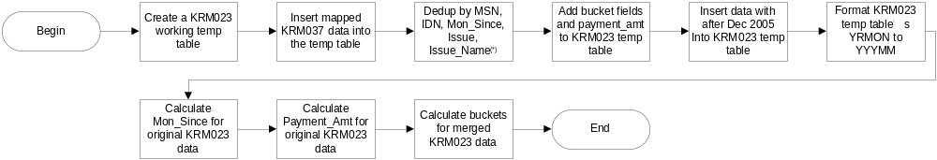
PREPARE JCIC DATA
BAM087
KRM023 / KRM040
(*) The monetary data Items (Limit, Spread_Payment, Payment_Amt) are all summed up If case of duplication.
Should any of the record among the duplicated has cash advance, the de-dupped record Is marked as using cash advance.

Slide 42
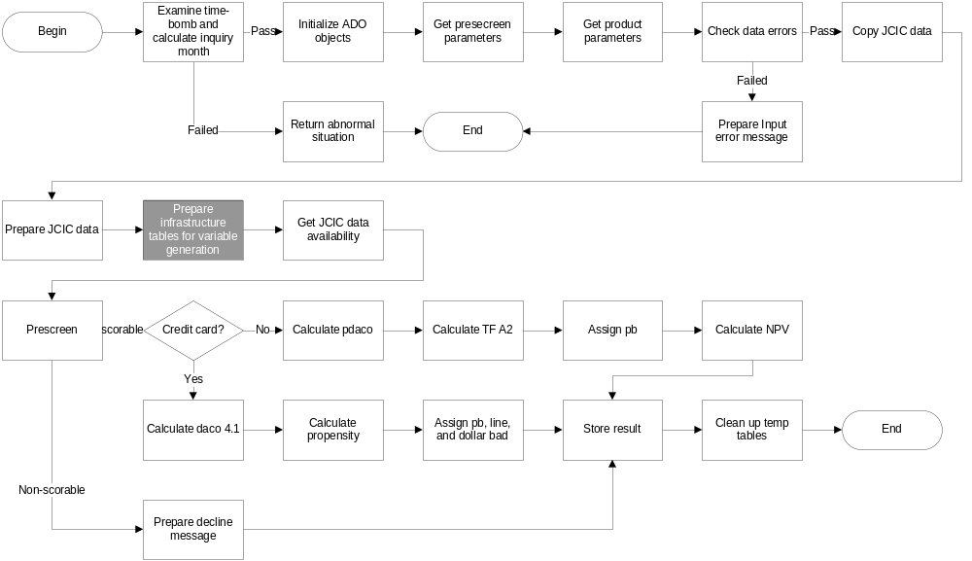
PREPARE VARIABLES GENERATION INFRASTRUCTURE

Slide 43
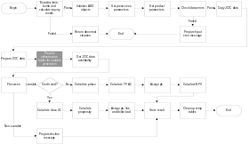
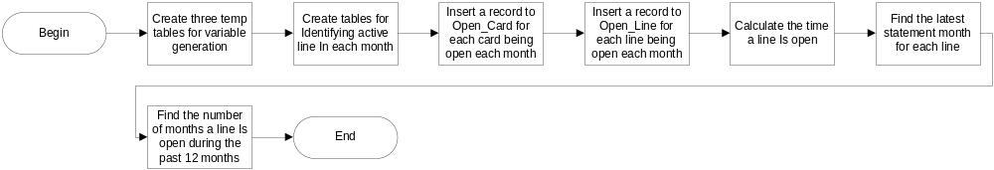
PREPARE VARIABLES GENERATION INFRASTRUCTURE
(*) The monetary data Items (Limit, Spread_Payment, Payment_Amt) are all summed up If case of duplication.
Should any of the record among the duplicated has cash advance, the de-dupped record Is marked as using cash advance.

Slide 44
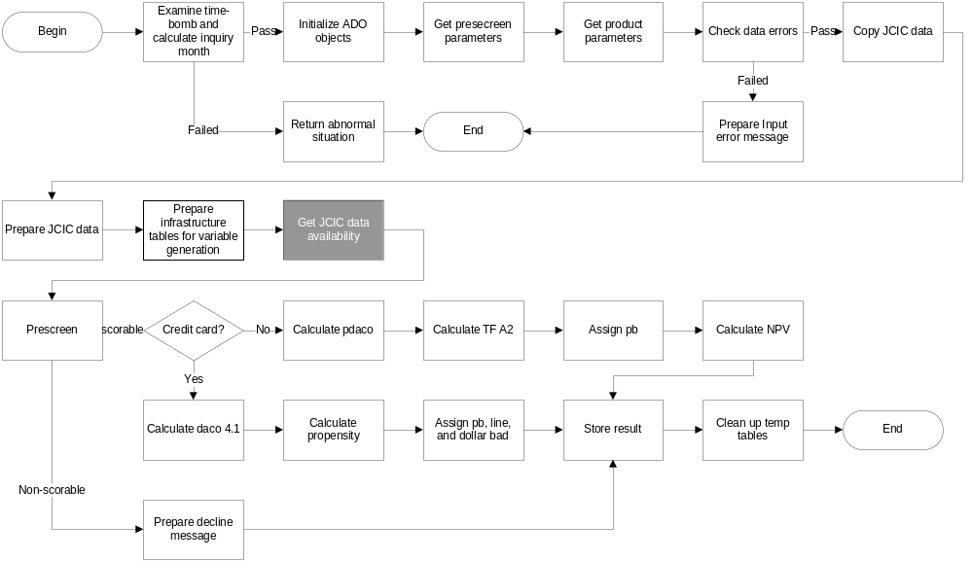
GET JCIC DATA AVAILABILITY

Slide 45

GET JCIC DATA AVAILABILITY
JCIC data availability flag
0x00 : No JCIC data
0x01 : KRM023 / KRM040 hit
0x02 : KRM021 hit
0x04 : BAM087 hit
0x08 : STM007 hit
0x10 : JAS002 hit

Slide 46
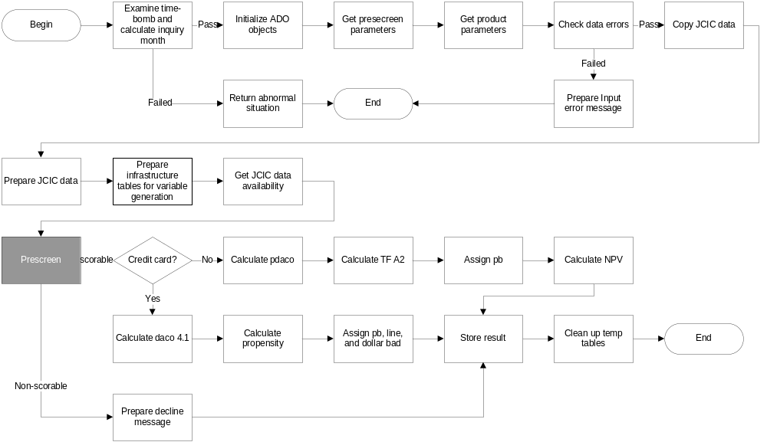
PRESCREEN

Slide 47
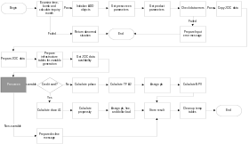
PRESCREEN
Prescreen exclusion flag
0x0000 : Pass prescreen
0x0001 : No KRM023 / KRM040
0x0002 : No KRM021
0x0004 : KRM023 max bucket > 3 (ef, 1K)
0x0008 : Earliest KRM023 month less than 6 months ago
first KRM021 card open less than 7 months

Slide 48
PRESCREEN
Prescreen exclusion flag (CONT.)
0x0010 : BAM086 Pass_Due_Amt > 0
0x0020 : JAS002 major derag
0x0040 : BAM086 cash card delinquent in latest month
0x0080 : BAM086 cash card utilization >= designated % (default value: 95%)
0x0100 : BAM086 max bucket > 1
0x0200 : KRM023 total utilization > designated % (default value: 75%)
0x0400 : Unsecured revolving balance(*) >= designated amount
(default value : NT$500K)
0x0800 : Total lines no more than 2 and has at least one delinquent line
0x2000 : KRM023 pay_code are all 'X' and 'X' only
0x4000 : KRM023 debt_code is A/B
(*) : Unsecured revolving balance = KM023 revolving balance in most recent month +
KRM040 spread_payment from revolver or cash advance user + BAM086 cash card balance

Slide 49
PRESCREEN
MAPPING PRESCREEN CODE TO EXCEPTION CODE
Prescreen exclusion flag | Exception code
0x0020 | 101
0x0004 | 102
0x0040 | 103
0x0080 | 104
0x0010 | 105
0x0100 | 105
0x4000 | 107
0x0400 | 108
0x0001 | 201
0x0002 | 201
0x0008 | 201
0x2000 | 201
0x0200 | 203
0x0800 | 204

Slide 50
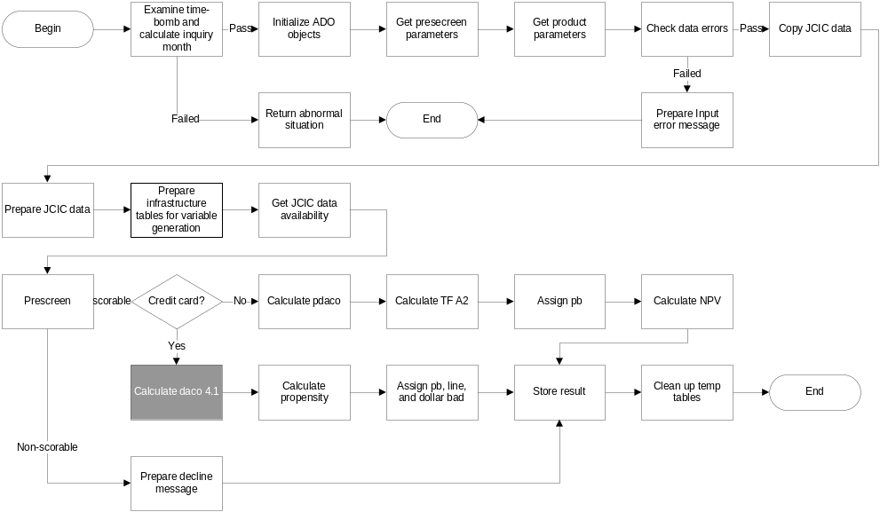
CALCULATE DACO 4.1(FOR CREDIT CARD ONLY)

Slide 51
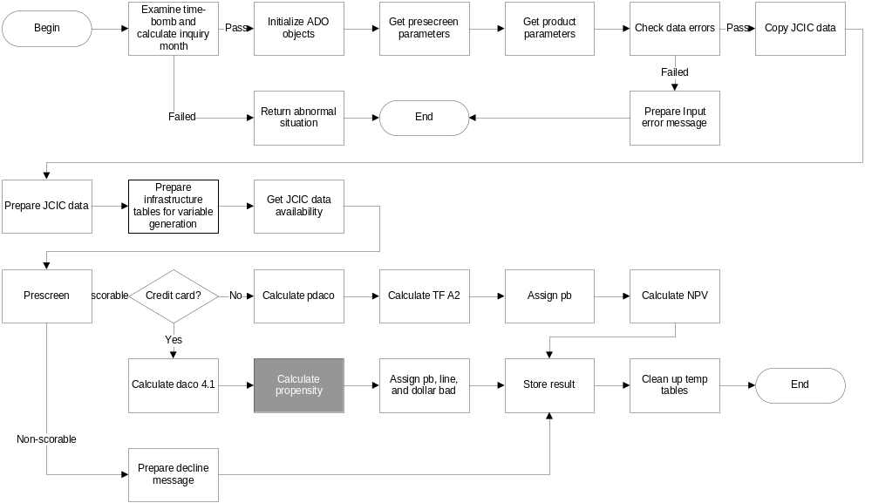
CALCULATE PROPENSITY(FOR CREDIT CARD ONLY)

Slide 52
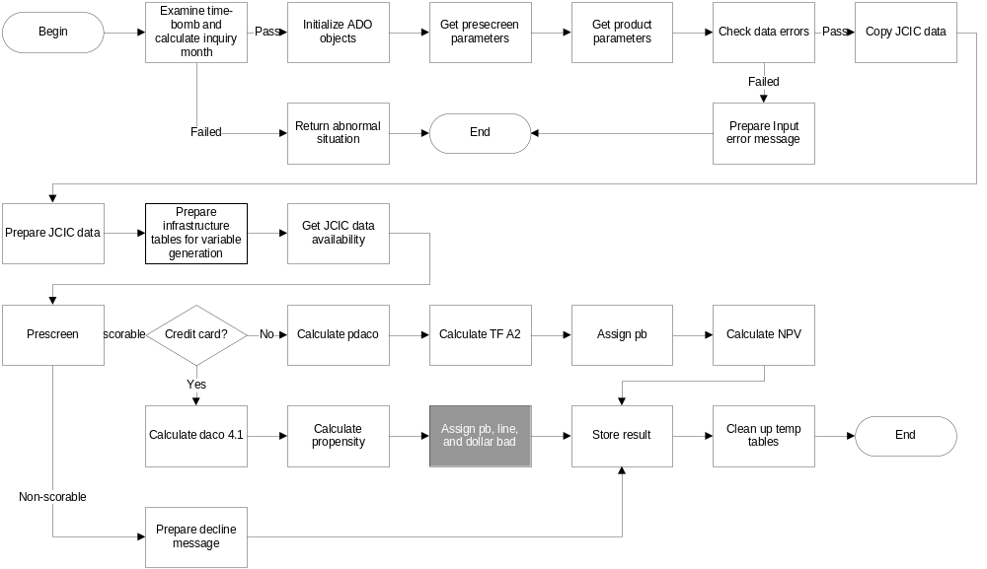
ASSIGN PB, LINE, AND DOLLAR BAD(FOR CREDIT CARD ONLY)

Slide 53

ASSIGN PB, LINE, AND DOLLAR BAD
R = DACO 4.1 twentile; P = propensity twentile

Slide 54
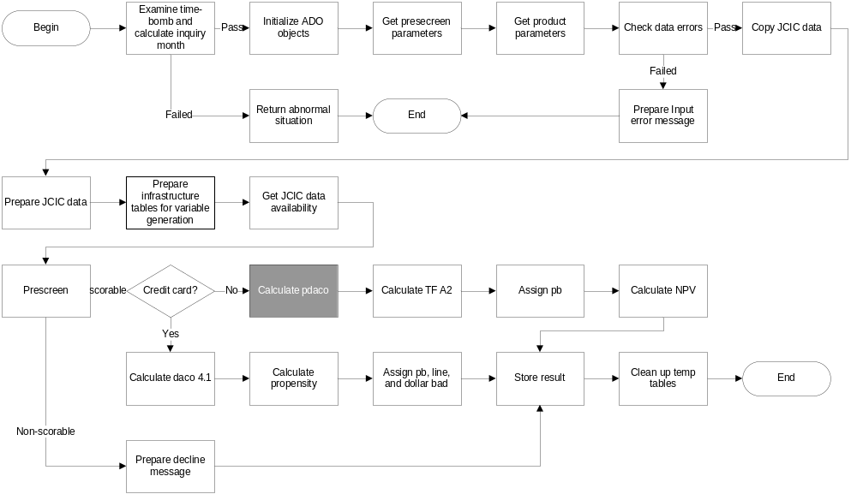
CALCULATE PDACO(FOR BALANCE TRANSFER ONLY)

Slide 55
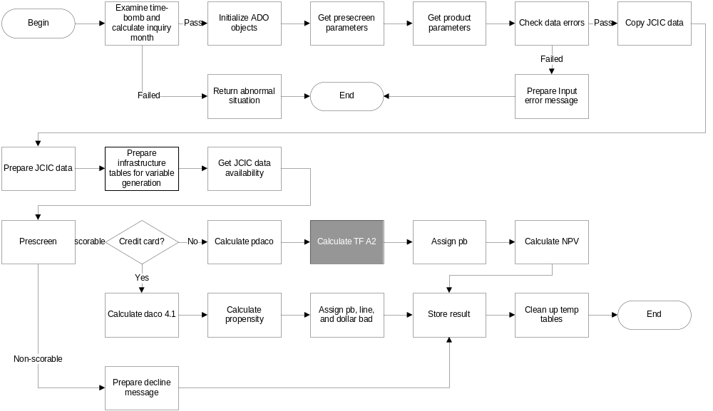
CALCULATE TF A2(FOR BALANCE TRANSFER ONLY)

Slide 56
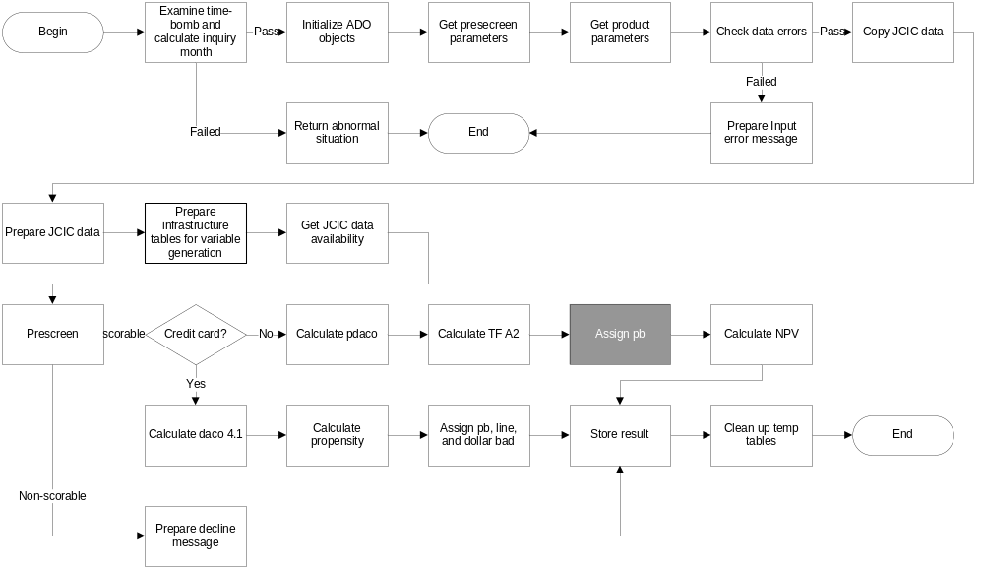
ASSIGN PB(FOR BALANCE TRANSFER ONLY)

Slide 57
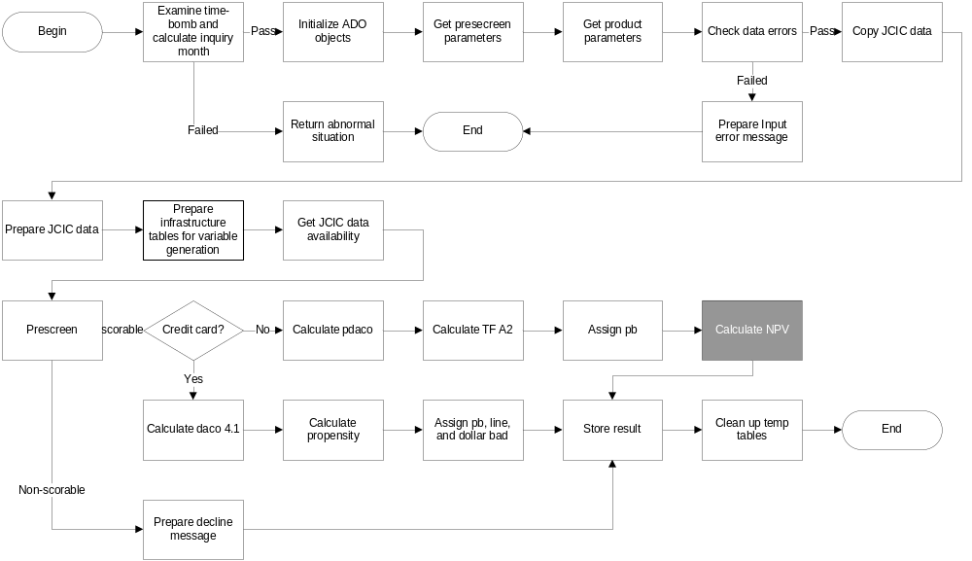
CALCULATE NPV(FOR BALANCE TRANSFER ONLY)

Slide 58
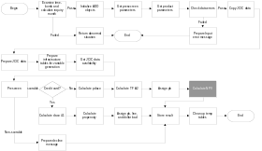
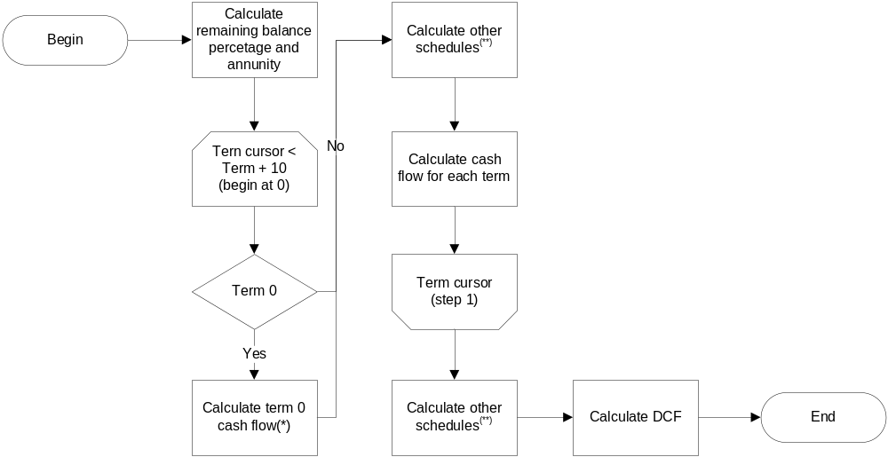
CALCULATE NPV(FOR BALANCE TRANSFER ONLY)
(*): setup fee, commission, Initial BT balance
(**): remaining BT balance, Interest revenue, Interest cost, pre-collection cost, collection cost, final collection cost,
delta working capital, management fee, operation expense

Slide 59
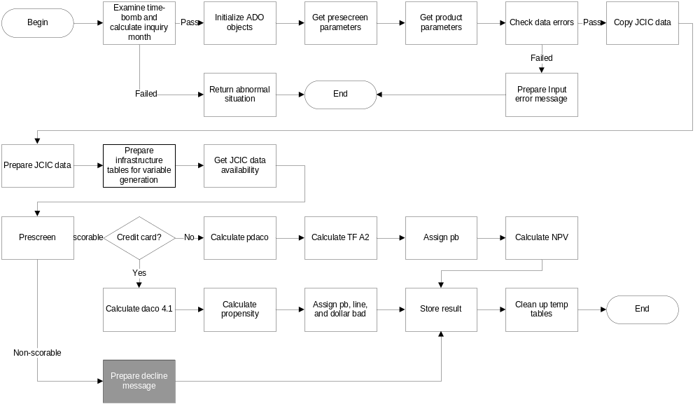
PREPARE DECLINE MESSAGE

Slide 60
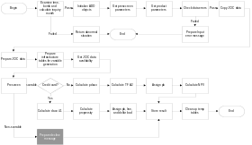
DECLINE MESSAGE
Exception code | Decline message
0 | The approval module has expired.
1 | 本DAC核准模組僅供華僑銀行使用。
101 | 建議婉拒，重大信用瑕疵。
102 | 建議婉拒，信用卡繳款記錄不良。
103 | 建議婉拒，現金卡近期有逾期。
104 | 建議婉拒，現金卡動支比率大於百分之XX。
105 | 建議婉拒，貸款繳款記錄不良。
106 | 建議婉拒，對華僑銀行貢獻度過低。
107 | 建議婉拒，信用卡有催收或呆帳註記。
108 | 建議婉拒，信用卡與現金卡餘額大於新台幣XXX元。
201 | 建議人工審核，JCIC資料不足。
202 | 建議人工審核，餘額代償申請金額超過限制。
203 | 建議人工審核，信用卡循環金額大於額度的百分之XX。
204 | 建議人工審核，信用卡額度數 <= 2且半數以上信用卡曾經延遲繳款。

Slide 61
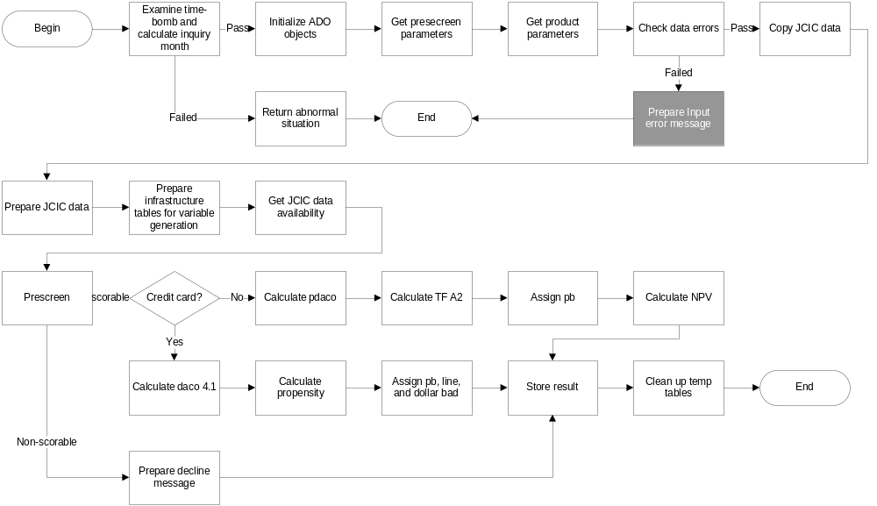
PREPARE INPUT ERROR MESSAGE

Slide 62
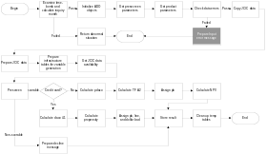
INPUT ERROR MESSAGE
Exception code | Decline message
301 | 無法辨識產品性質別。
302 | 代償金額小於或等於零。
303 | 代償筆數小於或等於零。
304 | 代償優惠期數(月)小於零。
305 | 代償優惠利率期數加總不等於代償優惠總期數。
306 | 無法辨識代償手續費。
307 | 無法辨識代償手續費收取方式。
308 | 每月代償手續費錯誤。
309 | 代償年利率小於零或大於信用卡利率。
310 | 信用卡年利率錯誤。
311 | 代償手續費收取期數(月)錯誤。
312 | 無此申請件資料。
313 | 申請件資料重複。
314 | 無法辨識卡別。

Slide 63
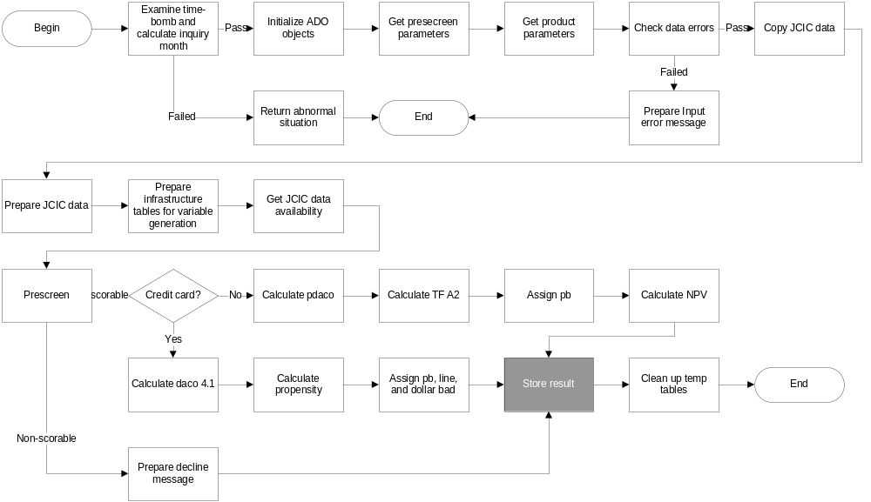
STORE RESULT

Slide 64
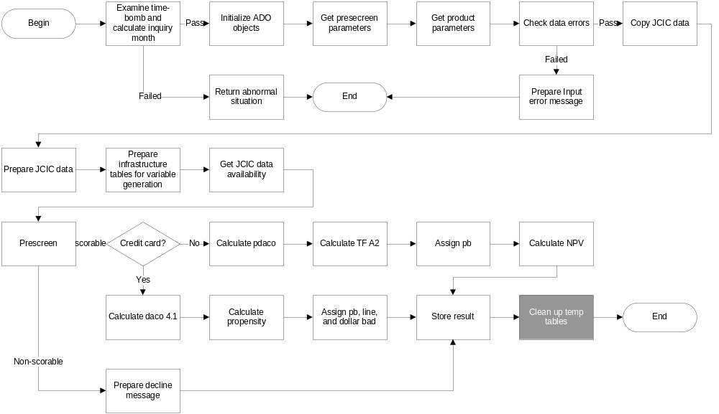
CLEAN UP TEMP TABLES

Slide 65
CONTENTS
Technical highlights
Input and output environment
Application Programming Interface
Program flow
Program files

Slide 66
PROGRAM FILES
File name | Description
cc_am.cpp | Risk model (DACO 4.1) Propensity model Line and PB mapping tables Approval module logics
cc_am.h | Definition of JCIC working temp tables Functions declaration for cc_am.cpp
cc_err.cpp | Exception codes and suggestion messages
cc_err.h | Functions declaration for cc_err.cpp

